Slide 1
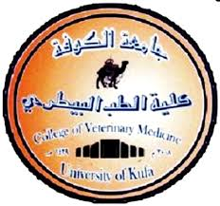
Introduction of Anatomy
Dr.Waleed Al-Kelaby Assist. prof .of anatomy, histology and embryology dep.
University of kufa
Faculty of veterinary medicine .

Slide 2
General introduction
Anatomy: is the branch of biological sciences, which deals with the form, and structures of organisms. It is close correlation with physiology, which deals treats of the function of the body.
Etymologically: the word anatomy signifies the cutting or disassociation of parts of the body

Slide 3
The types of the anatomy:
Macroscopic or gross anatomy: study the structures by naked eye.
Microscopic anatomy or histology: study the finer details of structures and minute organisms by microscopic.
Embryological or development anatomy: the study of the changes, which organisms undergo during their development from zygote to delivery.
Comparative anatomy: the description and comparison of the structures of the animals, and form the basis for their classification.
Special anatomy: is the description of the structures of the single type or species.
Veterinary anatomy: is the branch which deals with the form and structures of the principle of domestic animals.

