Slide 1

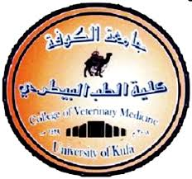
Anatomy of Digestive system
Dr.Waleed Al-Kelaby
Assist. prof .of anatomy, histology and embryology dep.
University of kufa
Faculty of veterinary medicine .

Slide 2
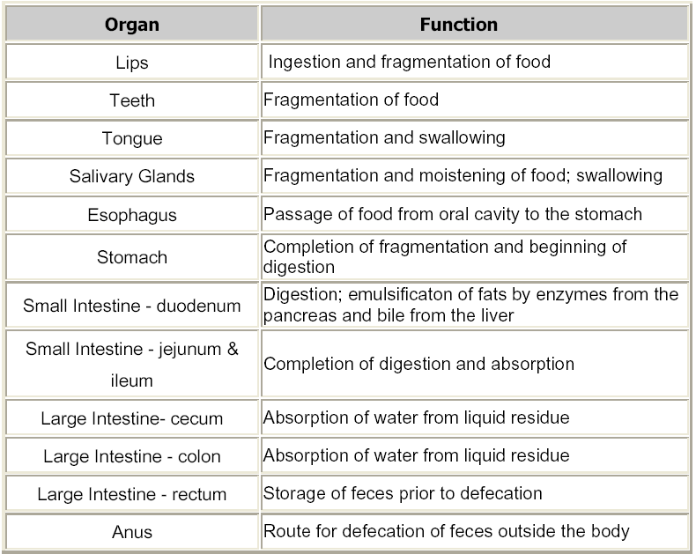
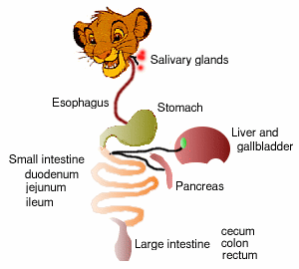

Digestive system

Slide 3
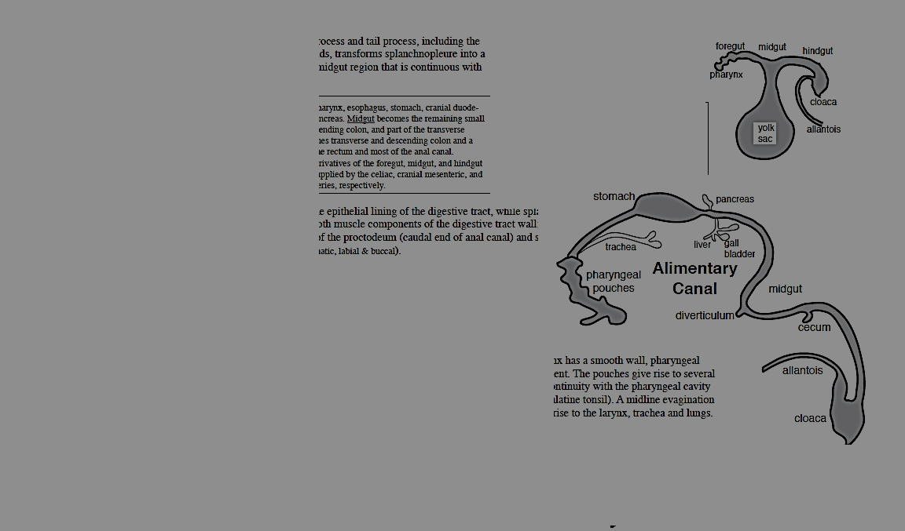
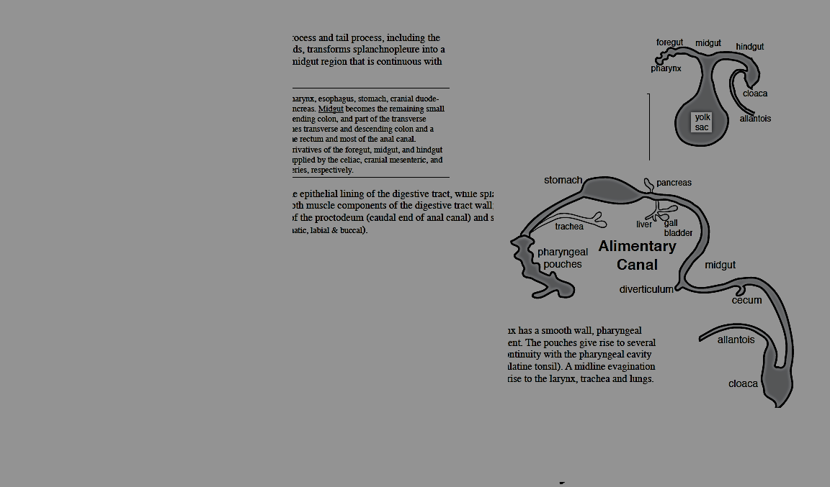
Development of digestive system
endoderm
the primitive gut
the forgut:develops the mouth, esophagus and pharynx.
the hind gut: develops the large intestine
the mid gut: develops the liver, pancreas and intestine.

Slide 4
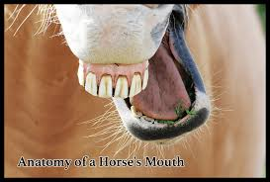
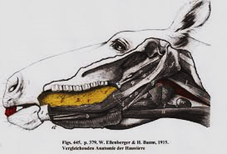
1- The mouth
Is the first part of digestive system, consist of oral cavity, which extend from lips to the entrance of pharynx.
The mouth cavity divided by teeth and alveolar process into two parts.
1- Oral cavity proper: is the space that bounded with teeth and alveolar process.
2- Vestibule of oral: is space extends to the teeth and alveolar process closed by the lips, checks and sub divided into two parts:
A-labial vestibule: is the space between the lips and incisors.
B-buccal vestibule: is the space between cheeks and premolar and molar (cheek teeth).

Slide 5
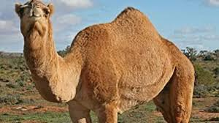
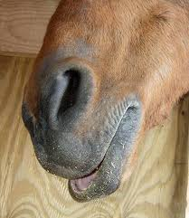
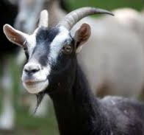
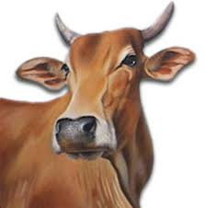
Lips
are two muscular ,membranous folds which surrounds the orifice of the mouth (present entrance of oral cavity ).
there are upper and lower lips which unite to each side at the angle of the mouth situated near the checks ,teeth are rounded ,each lip have two surface and two borders .
A-External surface :is covered by the skin which have variable number of hairs
,upper lips presents median furrow in the small ruminants and carnivores , in ,
lower lips present around prominence called the chin (mentum) which is
muscular adipose tissue.
B-Internal surface: is covered mucous membrane which is commonly more or
less pigmented, the small papillae in the surface show on there summit of the
opening of the glands small central folds of mucous membrane connecting the
lips to the gum called labial frenulum (maxillary and mandibular).
C-Free border: is the dense, have short and stiff hairs in some species.
D-Attached border: continuous with surrounded structures.

Slide 6
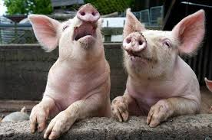
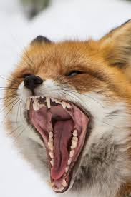
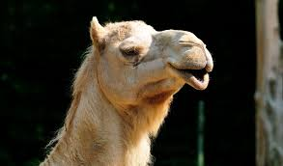
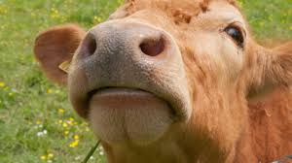
Comparative
1-The lower lips smaller the upper in the carnivores and pig.
2-In ox and horse, it present chins (mentum).
3-The upper lips of horse, sheep and carnivore are quite movable while in ox, pigs do not have freedom in motion.
4-The lips of ox is thick and not very movable in the middle part of the upper lips is the bale called nasal labial plenum ,is hairless, smooth and health animals cold and moist by salivary gland .
5-The upper lips of carnivores and small ruminants have middle furrow called philtrum (is shallow or absent in other animals).
6-The lips of sheep and goats are thin and very movable.

Slide 7
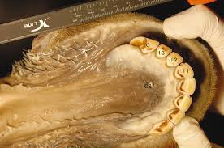
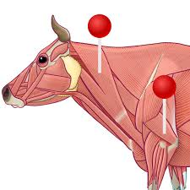
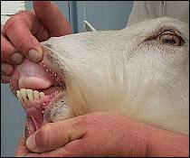
Cheeks
is caudolateral wall of the oral cavity , ,it extend from the angle of mouth to the pterygomadibular fold which connect between the palatine and mandibula caudal to the cheek teeth ,caudally the cheek have masseter muscles.
.in ruminants the mucous membrane of cheeks covered with conical papillae.
The gum or gingivae
is the oral mucosa which attached with the periostium of the alveolar process enclosed the necks of teeth, in ruminants the gum modified in upper incisors region to become thick and cornified epithelial cover replaced the upper incisors teeth and canines called dental pad

Slide 8
Teeth
Crown .which project from the alveolr*
Root .continned within the alvealur *
Neck. the area betweenthe crown and the root *
*Pulp cavity . the interior of teeth containing soft material and including vessels and nerves
which pass through formamen at the apex of the root.
the teeth of domestic mammals is classified as :
*Heterodont :since there are several groups of teeth each possessing certain characterstics adapted to specific function incisor cut .caninesseize and tear , premolars and molars shred or in most cases grind the food .
*Diphyodont : in that they passess a temparay set of teeth whick rupts early in life replaced by a permanent set

Slide 9
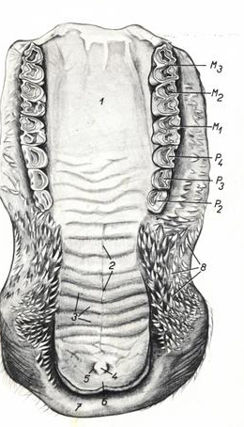
Hard palate
it is formed the roof of the mouth cavity, is osseous plate and is highly vascular mucosal covering that separated
the oral and nasal cavities.
It is bounded laterally by the upper dental arch and continuous caudally as soft palate
is formed
A-incisive bone + maxillary + palatine bones.
B-venous plexus (horse)
C-mucous membrane of mouth cavity,
There is central raphe divided the hard palate into two equal parts by the median palatine raphe which usually takes form of groove except in dog takes the form of crest ,each part contain transverse curved ridge (palatine ridges) .

Slide 10
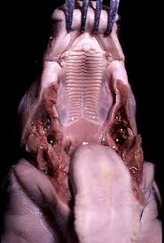
Soft palate
is the caudal extension of the hard palate , define as the muscular membranous fold, separate the mouth cavity from the pharynx. Divided the cranial part of the pharynx into two parts, oropharyngeal and nasopharyngeal, the cranial end of soft palate attached with hard palate, while the caudal end is free.
Horse: long 15cm. and caudally the free border located near the base of the epiglottis, in the swallowing the cranial part of epiglottis line against the dorsal surface of the soft palate, so that the horse unable to raise soft palate which is main reason which prevent the horse from vomiting and cannot breathing from mouth.
Soft palate
Pig: short, thick and caudal border present rudimentary.
Carnivores: long but not reach to the base of the epiglottis

Slide 11
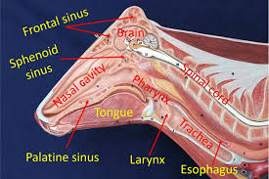
The pharynx:
Is a musculomemebranous sac which belongs to the digestive system and respiratory tract in common, it is funnel in shape which has:
1-large opening of the funnel face anteriorly and opens to the mouth and nasal cavity.
2-the small opening caudally and continuous by esophagus and larynx. The long axis of it, is directly oblique, it is about 15cm. in length.
The pharyngeal cavity has seven (7) openings
1-The paired posterior nose.
2-The paired eustachian tube
3-The oral opening (aditus pharynges)-
4-The laryngeal opening
5- The esophagus opening

Slide 12
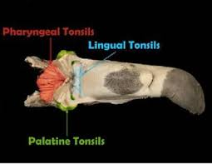
Lymphatic organs of the pharynx (tonsils):
lymphatic organs consist of combination of the large number of lymph nodules with diffuse lymphatic tissue. there are two types (follicular tonsils and non-follicular tonsil) and the both are surrounded by connective tissue capsule and well supplied blood vessels .they have efferent lymphatic, but not have afferent lymphatic.
The tonsils named according to their position in the pharynx:
1-lingual tonsil:
2-palato-tonsil:
3-tonsil of soft palate.
4-paraepiglottis tonsil:
5-pharyngeal tonsil:
6-tubal tonsil:

Slide 13
The tongue (lingu, glossa)
Is muscular membrane filing the mouth cavity, between body of mandible, it fills the oral cavity proper, the shape of it different according
to the species of animal, it consist of:
1-the root (radix lingua):.2-the body:3-the apex (toe):, frenulum linga.Function of lingua:
surfaces, except in dog have two surfaces:
A-dorsal surface (dorsum).B-lateral surface: it is flat, become round and C-ventral surface:
3-the apex (toe):, frenulum linga.Function of lingua:
1-main fold for the intake solid and liquid. 2-it is important tactile organ taste of food.
3 it is important in the mastication of food swallowing.
4-can is use for cleaning the skin and hair.

Slide 14
Structure of tongue
1-Intrinsic muscle:.
2-Lingual glands:.
3-Mucous membranous:
A-Mechanical papillae
1-Conical papillae
2-Lenticular papillae
3-Filliform papillae
B-Gustatory papillae
1-Fungiform:
2-Vallate papillae:
3-The foliate papillae

Slide 15
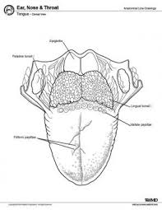
Innervation of the tongue:
1-taste (special sense): the sense of the rostral two third of the tongue is carried over the chorda tympani nerve, a branch of facial nerve.
2-taste from the caudal third of the tongue passes by the glossopharyngeal and vagus nerves.
3-sensation (pain, temperature and tactile) : carried over the lingual branch of the mandibular nerve.
4-motor innervation: by the hypoglossal nerve.

Slide 16
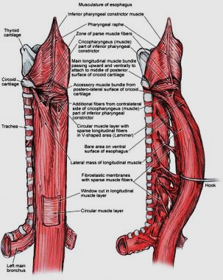
Alimentary canal
Is a tube, which extends from pharynx to the anus, consist of following segments:
A-esophagus. B-stomach. C-small intestine. D-large intestine.
The esophagus:
It is a musculo-membrance tube extending from the pharynx to the stomach. It is divided according their location into:
1-cervical part: is the long part it is about six inches longer then the thoracic part.
2-thoracic part.
3-abdominal part: is short part, it is about one inch
Structure of esophagus: consist of:
1-mucous membrane lining the esophagus is stratified squamous epithelial tissue.
2-sub mucosa consists of connective tissue formed from fibers and containing mucous gland to lubrication.
3-muscular layer: in horse only the striated muscle formed about 2/3 cranially in born along esophagus while smooth muscle mainly last about
4-adventitia.

Slide 17
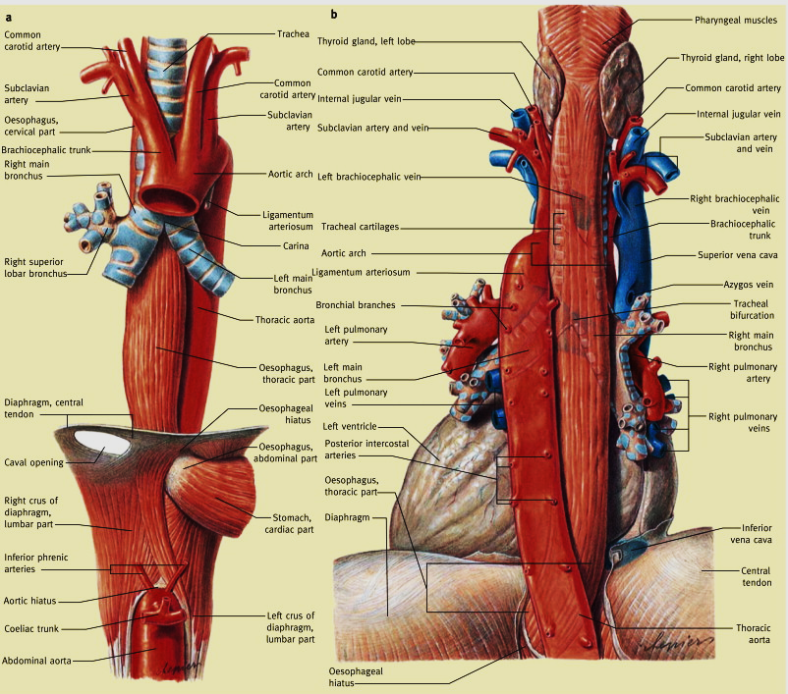
Course of esophagus
1-cervical part
Relations of esophagus in the cervical part:
1-cartilage of larynx. 2-common carotid artery 3-jugular vein
4-tracheal duct and cervical lymph nodes 5-vagosympathetic trunk.
6-caudal laryngeal nerve 7-in small animals (thymus gland)
2-thoracic part:
aortic arch .caudal to the base of heart, the esophagus lie between the lung ventral to the thoracic aorta and dorsal to the vagus nerve, finally it passes through the esophageal hiatus of the diaphragm.
3-abdominal part: is short and attached with stomach by the cardiostium.

Slide 18
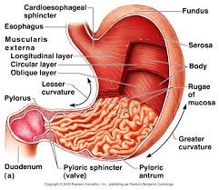
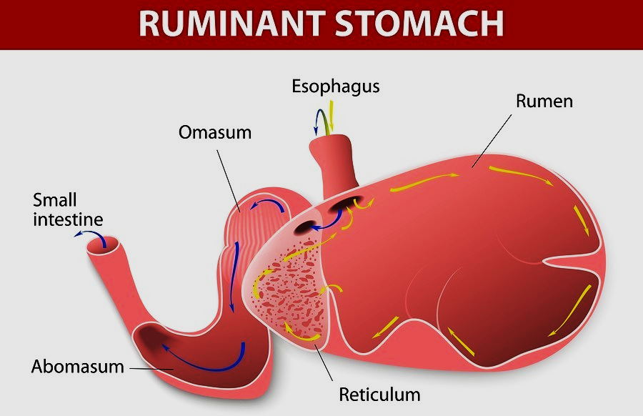
The stomach (gaster)
The stomach (gaster):
is the large dilation of the Alimentary canal caudal to the diaphragm, which located between the esophagus and the small intestine. It stores food temporarily and digests it chemically.
Classification of the stomach:
1- According to the number of cavities:
A-monolocular stomach: it is contains one cavity like in dog, horse, pig and all animals except ruminants.
B-multilocular stomach: it is contain many cavities like in ruminants (ox, goats and sheep).
2- according to the mucous membrane lining (inner lining):
A-simple stomach: it lines by one kind of mucous membrane (glandular mucosa), covered by simple columnar epithelium like dog, cat and man.
B-compound stomach: it lines by glandular and non glandular mucosa like in ruminants, pig and horse.

Slide 19
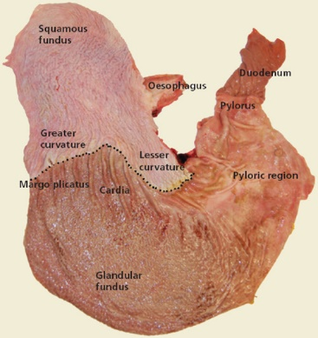
Stomach of horse:
1-it is monolocular compound stomach.
2-it is sharply curved, J-shaped sac,. It has two surface,two curvature and two extremities.
1-the parietal surface:
2-the visceral surface:.
The mucous coat is clearly divided into two parts:
1-non glandular part: lines the greater parts of the left sac resemble to esophagus mucous membrane and it is termed the proventicular part (esophageal region). It is white in color.
2-glandular part: it contains the gastric glands and sub divided into three zones according to the types of glands, which it contains:
A-cardiac gland region:
B-fundus gland region:.
C-pyloric gland region:

Slide 20
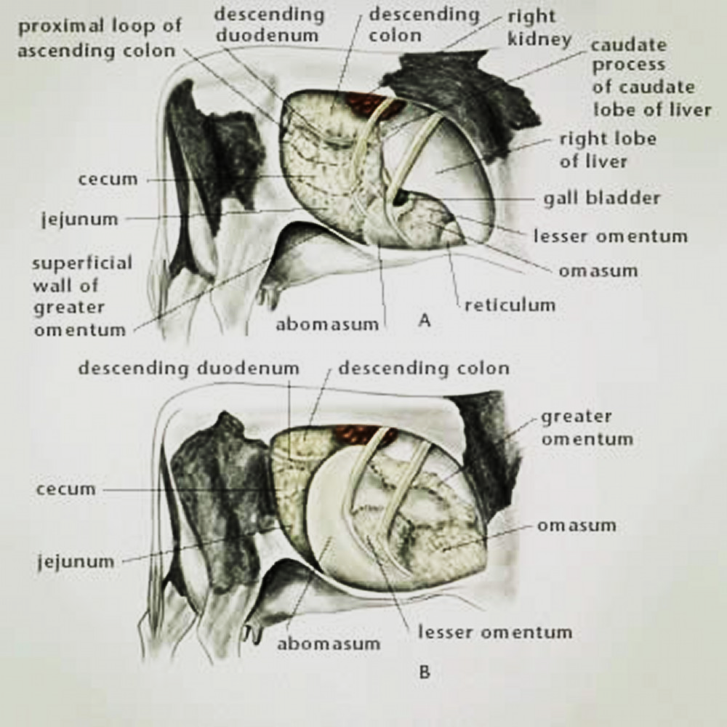
Fixation of stomach:
1-pressure of adjacent organs.
2-blood vessels supplying. -branches of the celiac artery. Gastric veins.
3-esophagus.
4-doudenum.
5-greater omentum .
6-lesser omentum, it divided into two parts:
A-the hepatodoudenal ligament .
B-the hepatogastric ligament .
7-gastrophrenic ligament .
8-gastrosplenic ligament .
9-gastropancreatic fold .

Slide 21
Stomach of Ruminants:
1-it is multilocular compound stomach.
2-it is occupied nearly ¾ of abdominal cavity, fill
in the left half of the cavity extends from diaphragm to the pelvic inlet and it may extend to the right side.
3-it consists of four compartments:
A-rumen B-reticulum C-omasum D-abomasums. The first three parts is non glandular called fore stomach or proventriculus, while the abomasums is a glandular mucous membrane called true stomach, the esophagus open into a shallow valuate between the rumen and reticulum and the abdomen continuous with the small intestine.

Slide 22
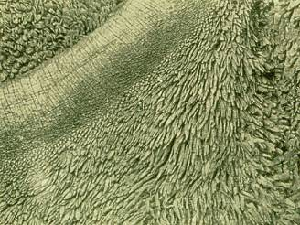
1-Rumen
1-Occupies most of the left half of abdominal
2-It compressed from side to side and has two surface, two curvature and extremities.
the parietal surface (left surface)
visceral surface (right surface):
dorsal curvature
ventral curvature
cranial extremity
caudal extremity
Internal surface:
: the mucous membrane of the rumen is brown or black sac except in the pillars part, it have rumenal papillae which is present in all parts of the rumen except in rumenal pillars, it is long in the ventral rumenal sac and short in the dorsal rumenal sac.
The rumen has two openings, cardiac orifice (funnel shape) and rumenoreticular opening

Slide 23
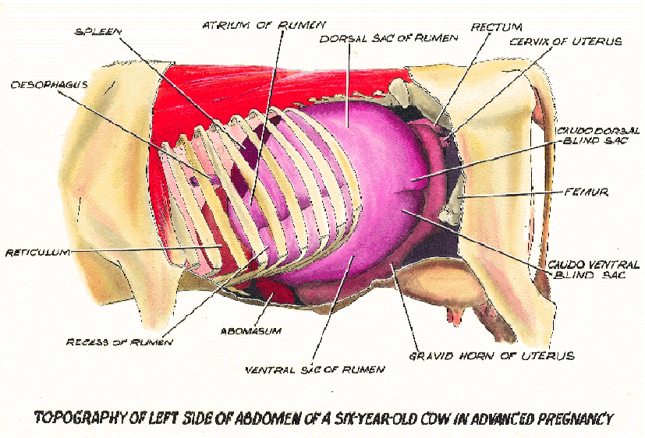
The relations of the rumen:
1-dorsally: diaphragm and sub lumber muscles 2-ventrally: abdominal wall.
3-left side: costal part of the diaphragm and spleen.
4-right side: omasum, abomasums and liver.
5-cranially:reticulum and diaphragm. 6-caudally: part of intestine.
The mucous membrane has, no glands and covered by stratified squamous tissue.

Slide 24
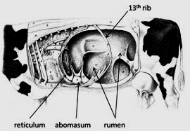
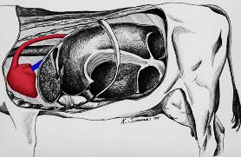
2-The reticulum
1-it is oval rounded in shape.
2-located cranially to the rumen (in ox is the smallest cavity) between the 6 and 7 or 8 rib in the left side of the median plane.
3-it has two surfaces and two curvatures, which are:
A-diaphragmatic surface: the diaphragm and pericardium.
B-Visceral surface:
C-lesser: connect with omasum, faces to the right and dorsal.
D-greater curvature:
The reticulum has two opening:1-rumenoreticular opening in lesser curvature.
2-reticulomasum orifice.
Relations of the reticulum:
1-dorsally: rumen. 2-ventrally: liver, sternal part of diaphragm and caudal end of sternum.
3-cranial: diaphragm. 4-caudal: omasum right side, left lobe of liver and abomasums.
5-left side: costal part of the diaphragm and ventral end of spleen.
Inner surface has shape like honey comb, having small papillae and has reticular cells

Slide 25
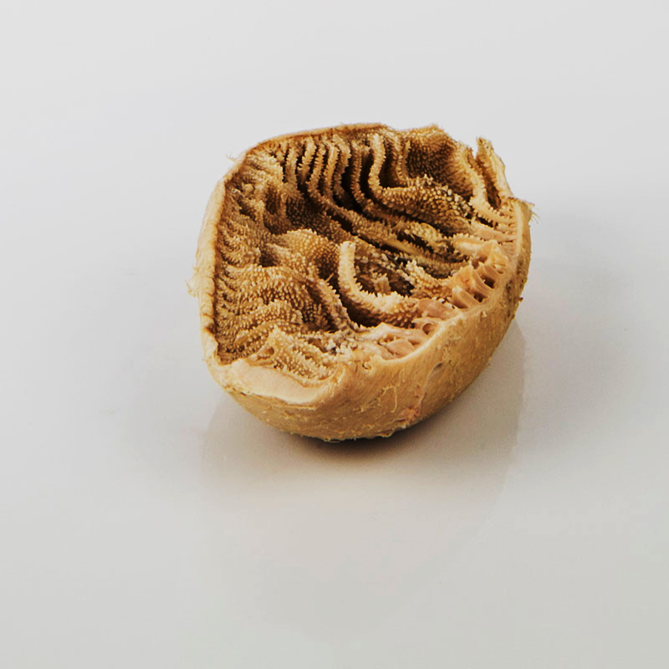
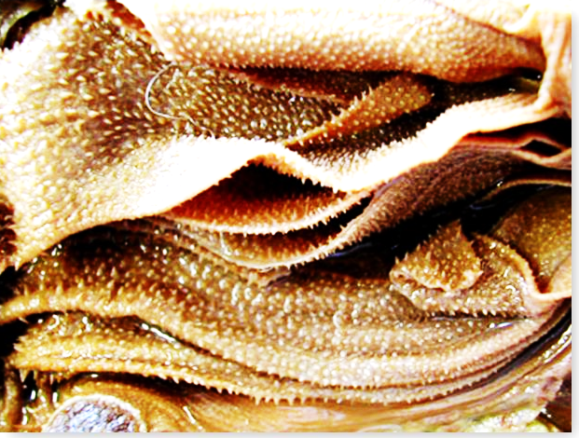
3-Omasum
It is ellipsoidal in form (in small ruminants is smaller than reticulum),. It has:
A-parietal surface (right):
-visceral surface (left):.
C-greater curvature:
D-lesser curvature:
Internal surface: It has:
1-omasal lamina: about (100) are present in the Ox and about (80) in Sheep
2-omasal groove: the omasal groove portion of the gastric groove, it passes from reticulum to abomasums.
It has two openings:
-reticulo-omasum orifice. 2-omasal-abomasums orifice.
Relations of omasum:
Dorsally: rumen, ventrally: abdominal wall, cranially: reticulum &-Caudally: intestine

Slide 26
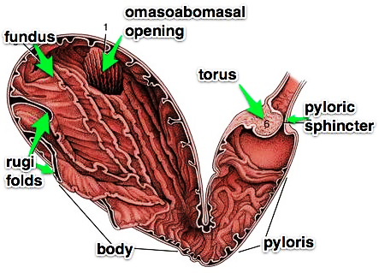
4-Abomasum:
1-it is an elongated sac which lies chiefly on the abdominal floor on right side.
2-it has:
A-cranial blind end:
B-body:. Lying more on the left than on the right of the median plane.
C-pyloric part:
3-externally, it has two surfaces and two curvatures:
A-parietal surface, B-visceral surface, C-greater curvature, D-lesser curvature,
4-the abomasums is lined by glandular mucous membrane.
The torus pyloricus: is a half rounded protuberance in the pylorus at the end of the lesser curvature and instead of pyloric sphincter in the horse.
Relation of abomasum:
dorsally: intestine, ventrally: abdominal wall , left side: rumen &right side: liver
Gastric groove (ventricular groove):

Slide 27
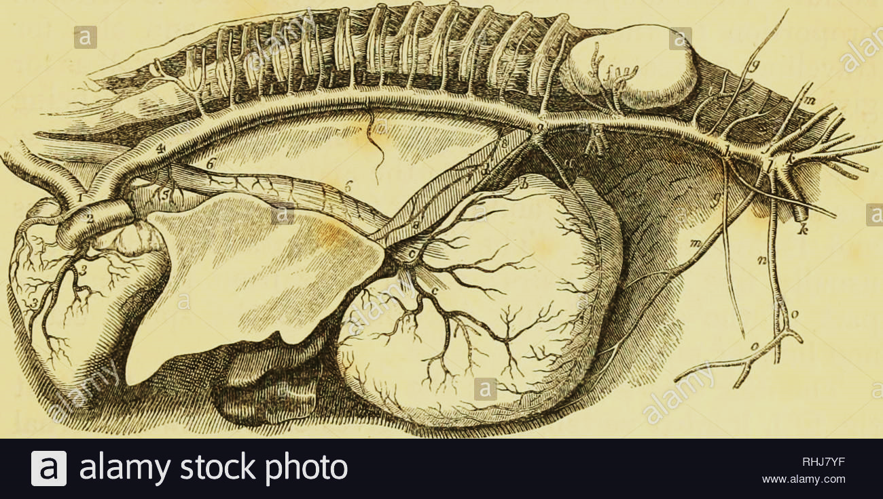
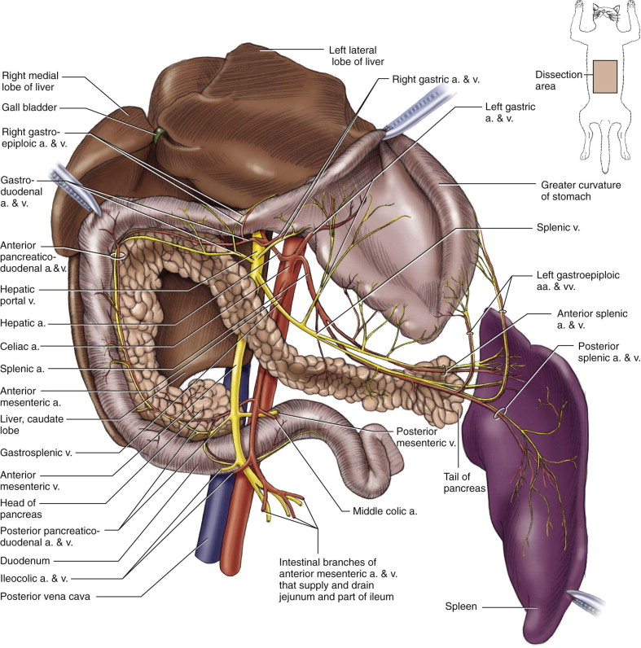
Blood supply of stomach:
Celiac artery : arise from abdominal aorta , which innervate the stomach , liver , spleen and pancreas .
It divided into :3 branches
Left gastric artery a-pancreatic branch.
b- esophageal branch.
c- parietal branch.
d- visceral branch .
Hepatic artery : a-pancreatic branch .
b-right gastric artery .
c- gastero duodenal artery .
Splenic artery : a- pancreatic branch .
b-splenic b.
C-short gastric a.
D- Left gastric epiploic a .

Slide 28
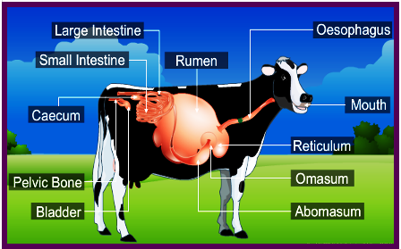
The intestine:
It is a tube extend from the stomach to the anus, it divided into two groups (small intestine and large intestine).
Small intestine:
It is tube, which connects the stomach with large intestine, it begins at the pylorus and terminates at the junction of colon and cecum
suspended by the mesentery and includes:
A-Duodenum B-Jejunum C-Ileum
large intestine:
1-In the horse about: 70 feet. 2-In the cattle about: 130 f
3-In the sheep about: 8o feet. 4-In the dog about: 5 times the body length of the animals
A- cecum B-colon C-rectum

Slide 29
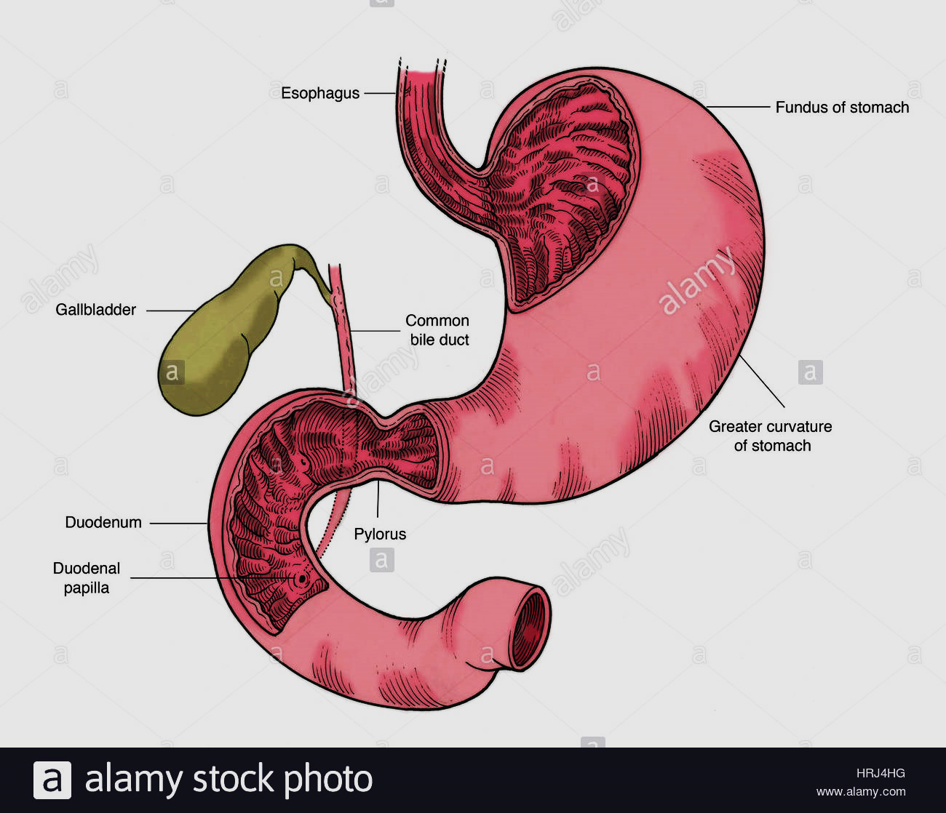
The duodenum:
1-It is first part of small intestine; it has shape like a horse shoe
2-It consists of 3 parts and 3 flexures:
1-The parts:
A-cranial part: V-shape and ended by the cranial flexure, in horse and ruminants and pigs is sigmoid shape, it receive bile duct from the liver and pancreas. Contained ampulla of vatter or hepatopancreatic ampulla
B-Descending part:
C-Ascending part:
2-The flexures:
A-cranial duodenal flexure they are where the cranial part turns to course.
B-caudal duodenal flexure after descending part.
C-doudenojejunal flexure the portion which turns caudally to be continuous by the jejunum.
3-doudenum in the cranial part attached with the liver by hepatoduoddenal ligament.
4-in the horse there is hepatopancreatic ampulla, in which the pancreatic and hepatic ducts open on small papillae.
5-the cranial part of duodenum has sigmoid loop which is found in horse, ruminants and pigs.
6-the ascending duodenum connect with the descending colon near the jejunoduodenal flexure by the duodenocolic fold.
Mesenteric part: consist of two parts (jejunum and ileum), suspended to the roof of the abdomen by mesentery.

Slide 30
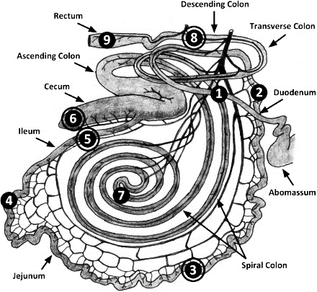
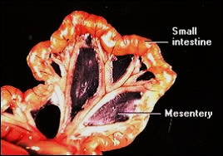
2-Jejunum:
It is the longest part of small intestine; it begins at the duodenojejunum flexure.
Located in dorsal part of the left half of the abdominal cavity from
the visceral surface of the stomach to the pelvic inlet.
In horse related with liver, spleen, and pancreas and
cranial part of colon. In ruminants form numerous close
coilsarranged in festoon around the border of mesentery
The jejunum lies in supraomental recess on right side of the rumen therefore, related with pancreas, omasum, abomasums, liver and rumen.

Slide 31
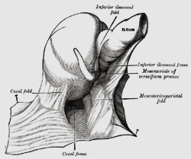
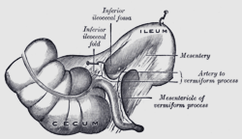
3-Ileum:
It is the terminal part of the small intestine extends from the free edge of ileocecal fold to the ileocecal orifice, it is smaller in all animals. It connect with the cecum by ileocecal fold, the ileocecal orifice guarded by sphincter muscle in all animals, except in horse there is venous plexus instead the sphincter muscle which acts the valve when full with blood.
Mesenteric part:
Connected with dorsal abdominal wall by the mesentery, this is a wide fan shaped fold consisting of two layers of peritoneum, between which the vessels and nerves reach the bowel; it also contains the mesenteric lymph nodes and some fats.
The visceral parts of the mesentery contains the intestine, while the parietal border or root of mesentery, is attached to small area around the cranial mesenteric artery under the first and second lumber vertebrae.
Ileal opening:
Ruminants ….ileo-cecocolic opeing .
Horse …..1- ileo-cecal opening 2- ceco- colic opening .
**end of ileum near (cecum with colon ) sourrounded by sphencter muscle in most animals except horse its absent .

Slide 32
The large Intestine
Extends from the termination of the ileum to the anus. It is divided into cecum, colon and rectum.
The cecum:
is the first part of the large intestine, is the blind sac extend from ileocecal opening to the beginning of the colon at the cecocolic orifice found at the right side of abdominal cavity in all, domestic animals except pigs found in the left side.
In horse:
1-it is curved like a comma shape.
2-both extremities are blind.
3--it have two openings are placed at the concave curvature are ileocecal orifice and cecocolic orifice.
4--it has base, body and apex:
5--the cecum has 4 longitudinal bands situated on the dorsal, ventral, right, left surface; these cause 4 rows of sacculation.

